Slide 1
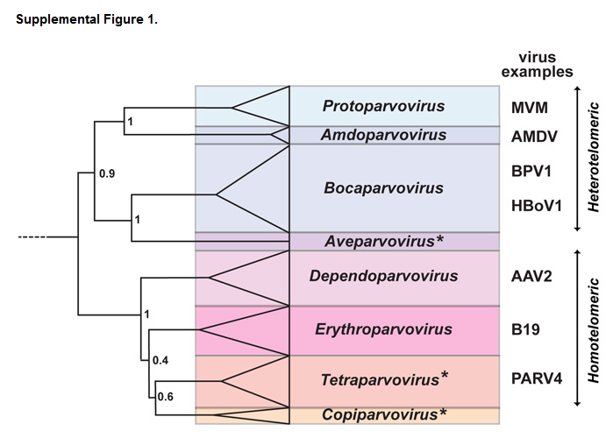
Cotmore, Tattersall. Parvoviruses: Small does not mean simple. S1

Slide 2
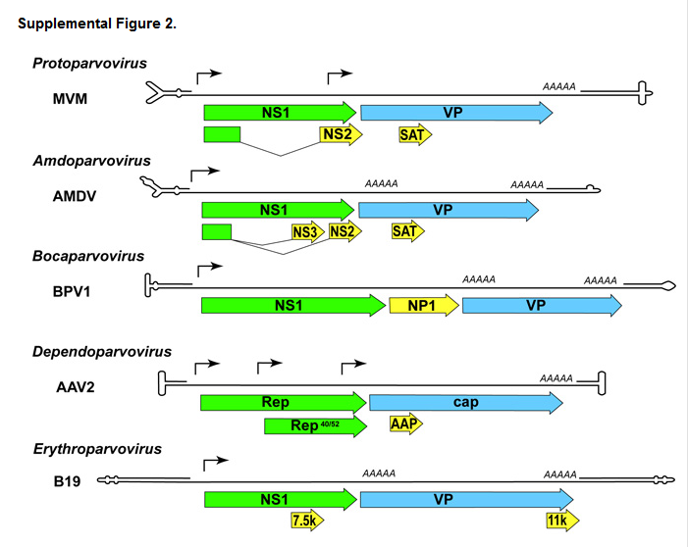
Cotmore, Tattersall. Parvoviruses: Small does not mean simple. S2

Slide 3
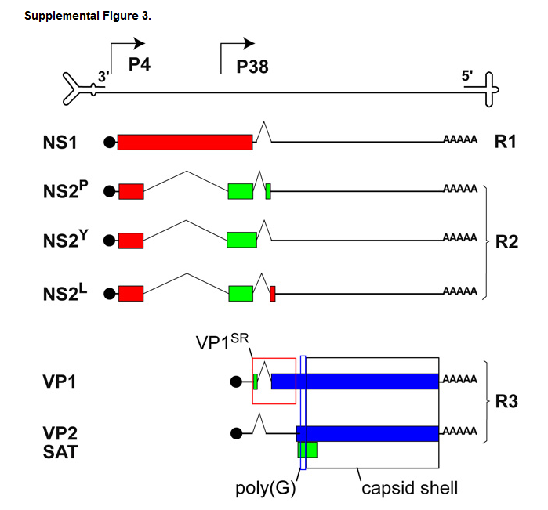

Slide 4
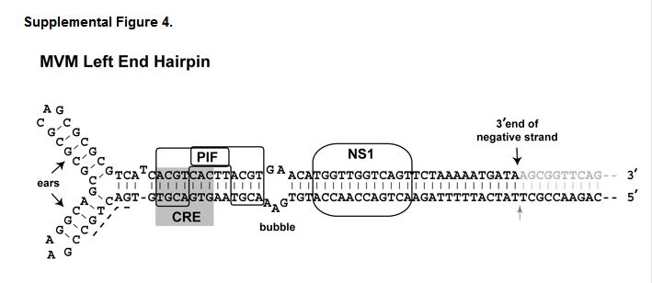
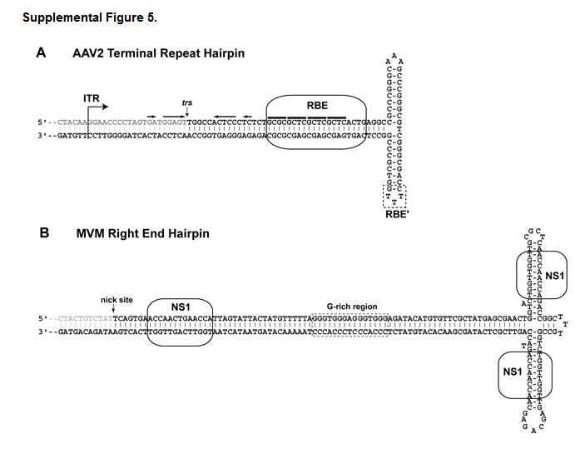

Slide 5
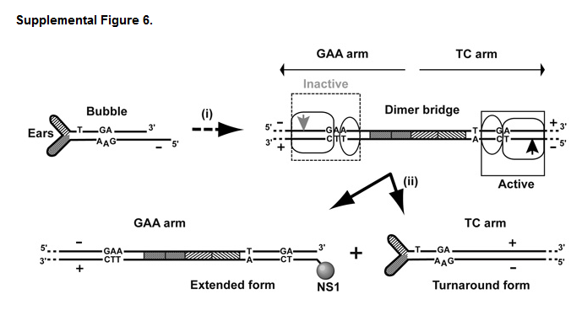

Slide 6
